Slide 1
Read Write Inc. Phonics
Parents’ Meeting
Set 2 and Set 3 Sounds
Notes:
Approximately 20 minutes is needed for this session.
Notes are provided to help you lead the presentation.
Notes in italics are for your attention only.
This bitesize parent session is best used alongside a demo of a Set 2 or Set 3 lesson action with a group of children.
Alternatively, you may wish to use a film from the School Portal.
Provide copies of ‘Reading at Home Booklet 2’ from Oxford Owl for each parent.

Slide 2
Reading changes everything
Teach a child to read and keep that child reading and we will change everything.
And I mean everything.
Jeanette Winterson
Notes:
Read quote.
Today I want to help you understand how your child is learning to read the next group of sounds in Read Write Inc. Phonics: Set 2 and Set 3 sounds.

Slide 3
Speed Sounds Set 2
Notes:
Set 2 sounds are shaded. They are long vowel sounds with 2 or more letters. We call these ‘Special Friends’ – two letters together that make one sound.
Let’s practise saying these sounds together.
Say each sound MTYT.
Once children know these Set 2 sounds, they know one way of reading and writing every sound.

Slide 4
Speed Sounds Set 3
Notes:
Once children know how to read Set 2 sounds, they start to learn Set 3 sounds.
These are shaded in the chart.
They are alternative graphemes (spelling of a sound) for the Set 1 and Set 2 sounds the children already know.
Point to the chart to show. For example, they know ‘ay’ and now learn a-e and ai as other spellings for the same sound.

Slide 5

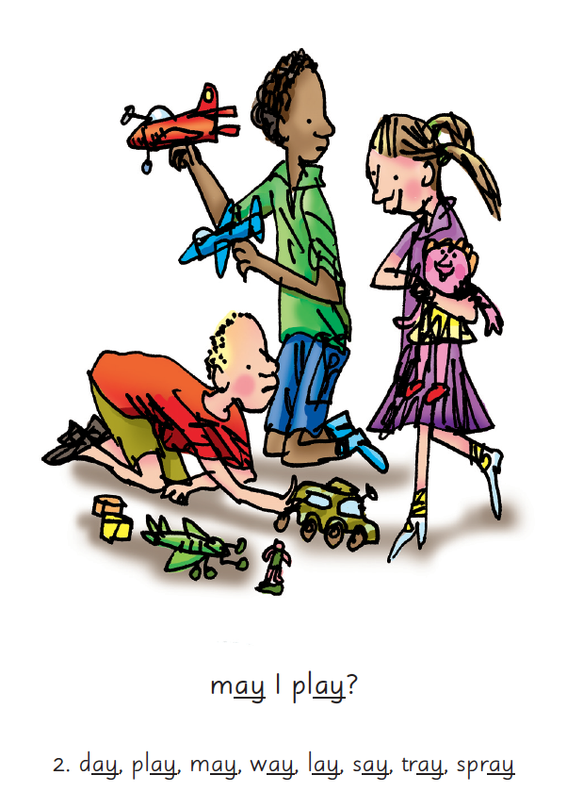

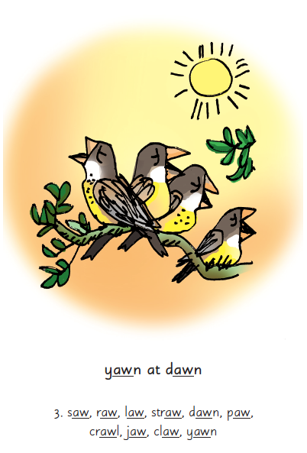
Picture Phrases
Notes:
We use picture phrases to help children remember the Set 2 and Set 3 sounds.
For example, ay, may I play? aw, yawn at dawn

Slide 6


‘Special Friends’, ‘Fred Talk’, read the word
Notes:
Then children practise reading these sounds in words using the routine ‘Special Friends’, ‘Fred Talk’, read the word’.
They spot the ‘Special Friends’ first, then Fred Talk to read the word.
For example, ‘ay’, s-p-r-ay, spray.

Slide 7
What can you do?
Practise the sounds and phrases
Practise reading sounds speedily -
‘review, review, review’
Use ‘Special Friends’, ‘Fred Talk’,
read the word’ to read words
Notes:
Show how to use Set 2/3 cards if you send these home.
You can purchase Set 2/3 flashcards or My Reading and Writing Kit ages 5-7 becoming a reader to support your child with Set 2 sounds at home.
I will give you a copy of ‘Reading at Home Booklet 2’ from Oxford Owl.

Slide 8
Online resources available
Ruth Miskin Parents’ Page:
http://www.ruthmiskin.com/en/parents/
Ruth Miskin Facebook:
https://www.facebook.com/miskin.education
Free e-books for home reading:
http://www.oxfordowl.co.uk/Reading/

Slide 9
Teaching Set 2/ 3 sounds - in action
Notes:
Now let me show you this in action with a group.
Demonstrate teaching a Set 2/3 sound to a group.
Alternatively, you may wish to use a film from the School Portal.

Slide 10
Reading changes everything
Teach a child to read and keep that child reading and we will change everything.
And I mean everything.
Jeanette Winterson
Notes:
Remember that all parents have the power to change outcomes for their children.

Slide 11
Any questions?
Q&A

